Slide 1

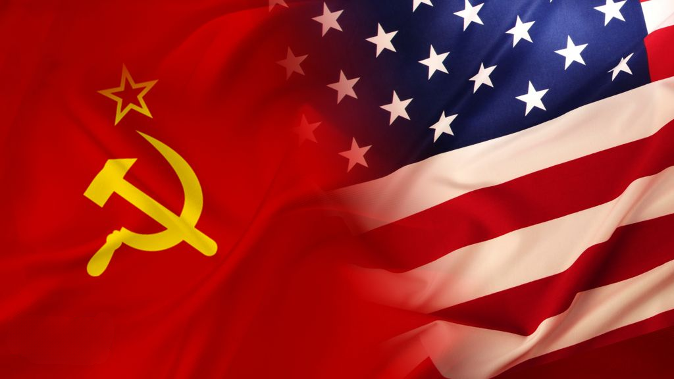


1945-1991
Chapter 27
THE COLD WAR
the cold war
Strand Three: The History of Europe and the Wider World
@MsDoorley

Slide 2
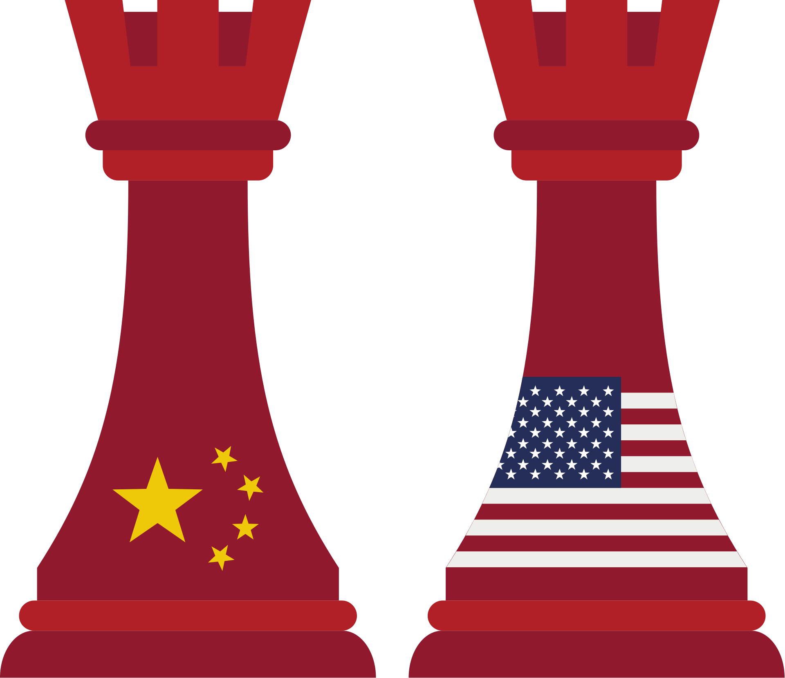

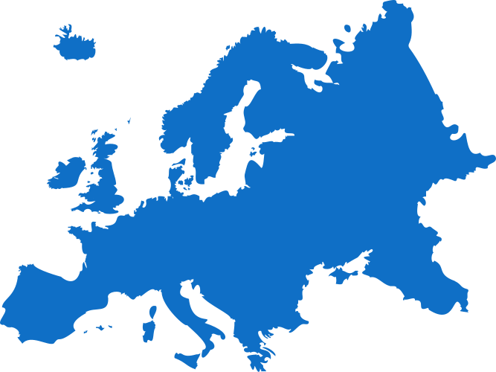
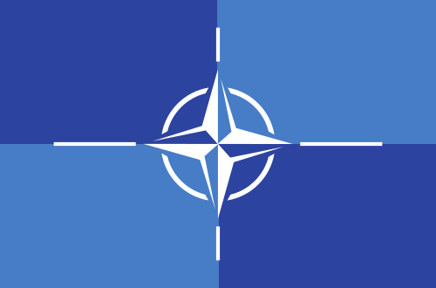

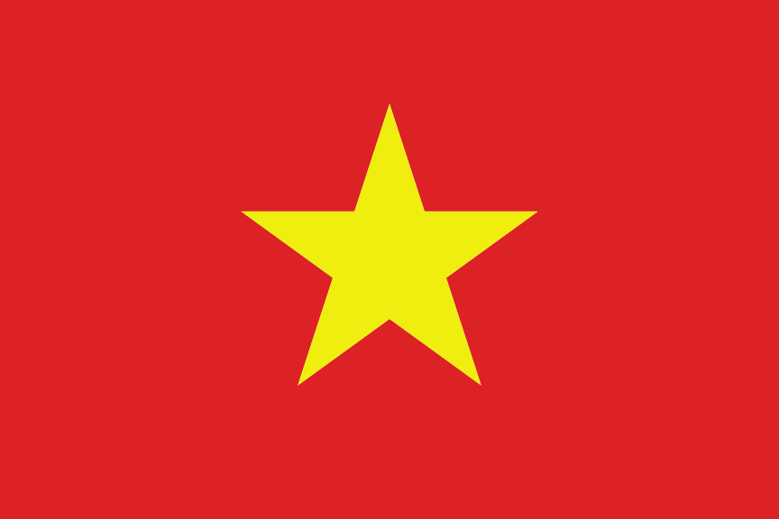

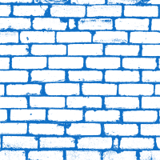
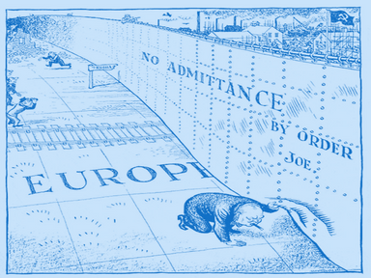

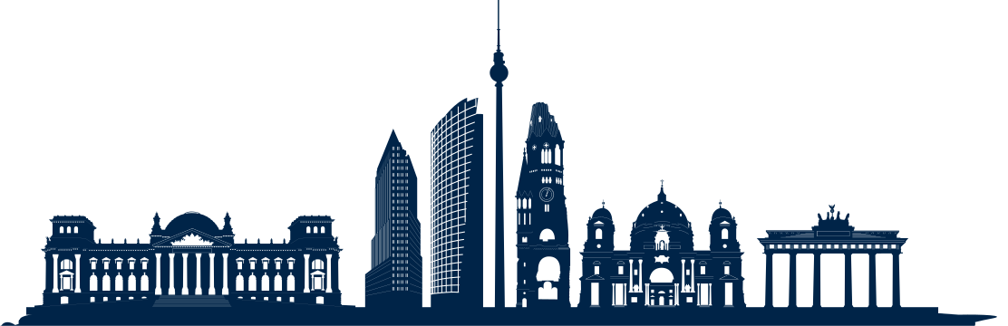
Chapter 27
THE COLD WAR
NATO is formed while USSR tests its first atomic bomb.
The Cuban Missile Crisis begins, bringing the World the closest to nuclear annihilation
The Vietnam War begins
Strand Three: The History of Europe and the Wider World
Chapter Twenty-Seven: The Cold War
1948
1949
1950
1955
1961
1962
1989
The Marshall Plan
and the Berlin Blockade marks the beginning of the Cold War
The Korean War begins
The Berlin Wall is built.
The Iron Curtain separates the USSR from Western Europe
The Fall of the Berlin Wall predates the Fall of the Soviet Union two years later.
@MsDoorley

Slide 3
Learning Outcomes
3.5 RECOGNISE the importance of the Cold War in international relations in the twentieth-century world
1.2 CONSIDER contentious or controversial issues in history from more than one perspective and discuss the historical roots of a contentious or controversial issue or theme in the contemporary world
1.7 DEVELOP historical judgements based on evidence about personalities, issues and events in the past, showing awareness of historical significance
Strand Three: The History of Europe and the Wider World
Chapter Twenty-Seven: The Cold War
@MsDoorley

Slide 4
Introduction
In the aftermath of World War II, the superpowers (the most powerful countries in the world) were the Soviet Union (USSR) and the United States of America (USA). They had been allies against their common enemy during the war against the Nazis was followed by a long period of tension between them and their allies. This period was known as the Cold War. The two sides would come close to armed conflict on a number of occasion but direct war between the USSR and the USA was avoided. This time period led to increased competition in technology, spying and sport along with small scale conflicts.
Strand Three: The History of Europe and the Wider World
Chapter Twenty-Seven: The Cold War
@MsDoorley

Slide 5
1945-1991
Chapter 27
27.1: THE CAUSES OF THE COLD WAR
27.1: the causes of the cold war
Strand Three: The History of Europe and the Wider World
@MsDoorley

Slide 6
Political differences: Communism vs Capitalism
At its heart, the Cold War was a conflict between two different ideologies. The Soviet Union was a communist country – the state controls all the property, industry and services; freedom (of elections, the media and the individual) are limited. The US was a capitalist economy – individuals are free to acquire wealth, own private property and profit from business with little interference from the government. It was also a democracy – where there were various political parties, people could vote in elections and free speech laws are in place.
Strand Three: The History of Europe and the Wider World
Chapter Twenty-Seven: The Cold War
@MsDoorley

Slide 7
Conflict and mistrust during World War II
Although they were allies against Hitler and Mussolini, there were tensions between the US and USSR during the war. Josef Stalin believed that Britain and the US had deliberately delayed the D-Day landings so that the Soviets suffered more damage by fighting the Nazis alone. In addition, the US also refused to share the secrets of the atomic bomb with the Soviets when they used it to defeat Japan in August 1945.
Strand Three: The History of Europe and the Wider World
Chapter Twenty-Seven: The Cold War
@MsDoorley

Slide 8
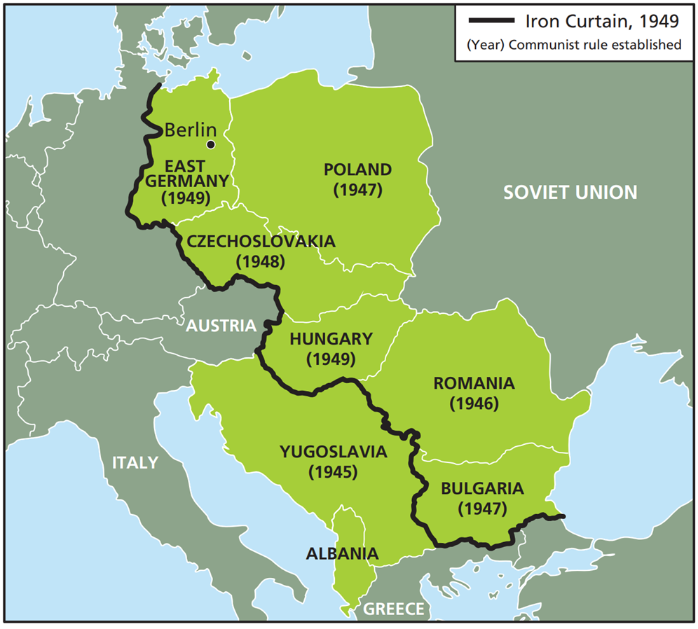
The Iron Curtain
After World War II, Stalin wanted to create a ‘buffer zone’ to protect the USSR from future invasions. He imposed communist governments on Poland, Czechoslovakia, Hungary, Romania and Bulgaria who were loyal to the Soviets. These countries became known as the ‘satellite states’ as they were under the control of Moscow. The West viewed this as the Soviets planning to take over the rest of Europe. In a 1946 speech, Winston Churchill used the term 'Iron Curtain' to describe the division of Europe.
Strand Three: The History of Europe and the Wider World
Chapter Twenty-Seven: The Cold War
Diagram taken from Artefact, 2nd Edition by Eimear Jenkinson and Gregg O'Neill (educate.ie)
@MsDoorley

Slide 9
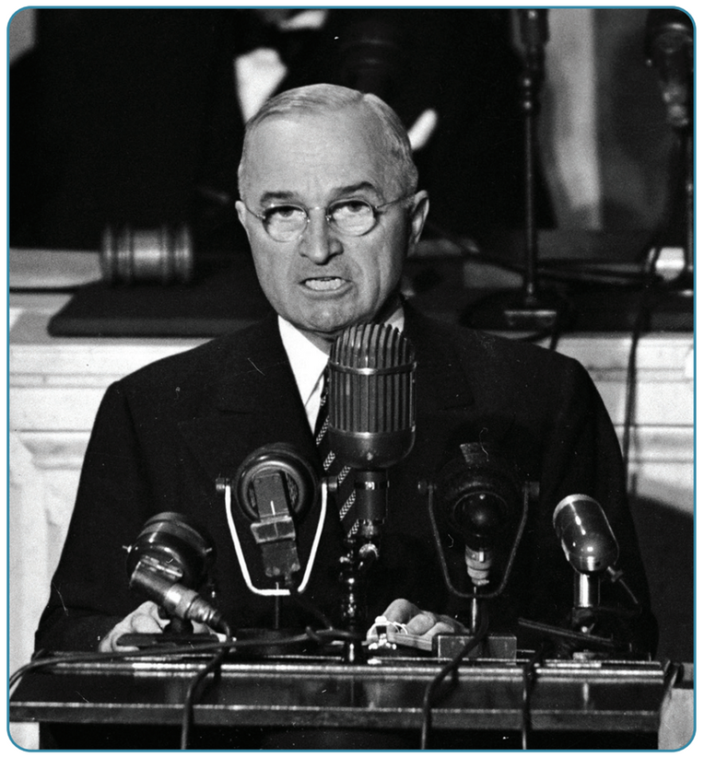
Containment
In response to the Soviets’ actions, US President Harry Truman announced a new policy called the Truman Doctrine. This policy declared that the US would provide military aid to any country that was fighting communist forces within its own state. In a speech to the US Congress in March 1947, Truman said: 'I believe that it must be the policy of the United States to support free peoples who are resisting attempted subjugation by armed minorities or by outside pressures'. The USA was afraid that if a country became communist, other countries nearby would follow and communism would spread further. This was known as the 'domino theory'.
In addition, the US government also announced the Marshall Plan (named after the US Secretary of State, General George Marshall) which would provide funds to help Europe rebuild after World War II with over $15 million spent. The policy of containment was introduced; the West could not remove communism from countries where it was already established, as it would mean war against the Soviets, but he did believe that he could limit its spread.
Strand Three: The History of Europe and the Wider World
Chapter Twenty-Seven: The Cold War
Diagram taken from Artefact, 2nd Edition by Eimear Jenkinson and Gregg O'Neill (educate.ie)
@MsDoorley

Slide 10
Checkpoint pg. 361 (Artefact, 2nd Edition)
  Explain the following terms; superpowers; the Cold War.
  Explain the differences between the political systems in the US and the Soviet Union.
  What tensions emerged between the Allies during World War II?
  What was the Iron Curtain? Why did Stalin take over Eastern Europe?
  How did the US respond to Soviet actions in Europe?
  What was the policy of containment?
  Which side do you think bore more responsibility for the beginning of the Cold War? Give reasons for your answers.
Strand Three: The History of Europe and the Wider World
Chapter Twenty-Seven: The Cold War
@MsDoorley

Slide 11
1945-1991
Chapter 27
27.2: THE BERLIN BLOCKADE, 1948-1949
27.2: the berlin blockade, 1948-1949
Strand Three: The History of Europe and the Wider World
@MsDoorley

Slide 12
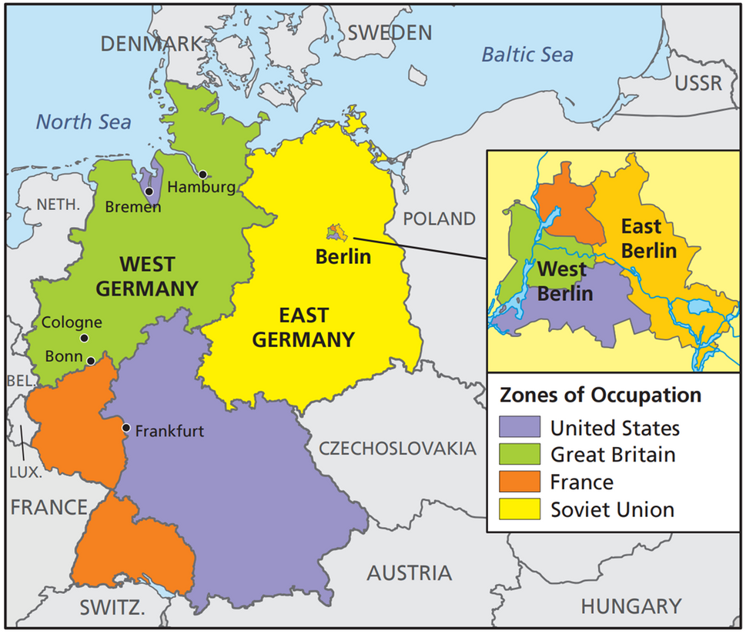
Germany after World War II
During the war, the Allied leaders had agreed how to deal with Germany after it was defeated; Germany would be divided into four zones, occupied by the Americans, British, French and Soviets. Berlin would be divide into four zones despite being in the Soviet zone. The division was supposed to be temporary.
Germany had been devasted by the war, both financially and structurally. The Allies disagreed about the future of the country; the West wanted to repair it while the Soviets wanted compensation.
Strand Three: The History of Europe and the Wider World
Chapter Twenty-Seven: The Cold War
Diagram taken from Artefact, 2nd Edition by Eimear Jenkinson and Gregg O'Neill (educate.ie)
@MsDoorley

Slide 13
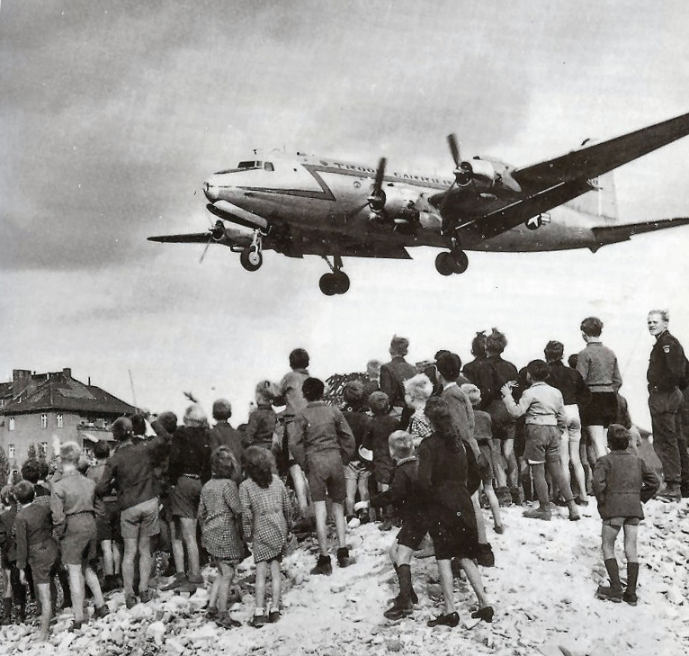
Berlin Blockade
Tensions came to a head when the Western allies united their zones under a new currency, the Deutschmark, to revive the German economy. The Soviets refused to allow the currency in their own sectors. Their retaliation came on 24th June 1948 by cutting off all road, rail and canal links to West Berlin. This became known as the Berlin Blockade. This was the first major confrontation of the Cold War.
Stalin hoped this would force the Allies to leave the city. The West was determined not to give into the Soviets and found a solution through air drops. They were gambling that Stalin would not risk all-out war by shooting down a supplies airplane. Codenamed Operation Vittles, the Berlin Airlift was a huge operation, with cargo planes bearing food, clothing, medical supplies and fuel for over 2.5 million people flying to and from three airports in West Berlin. The blockaded lasted 323 days; Stalin lifted the blockade when he realised that the Allies would not leave.
Strand Three: The History of Europe and the Wider World
Chapter Twenty-Seven: The Cold War
@MsDoorley

Slide 14
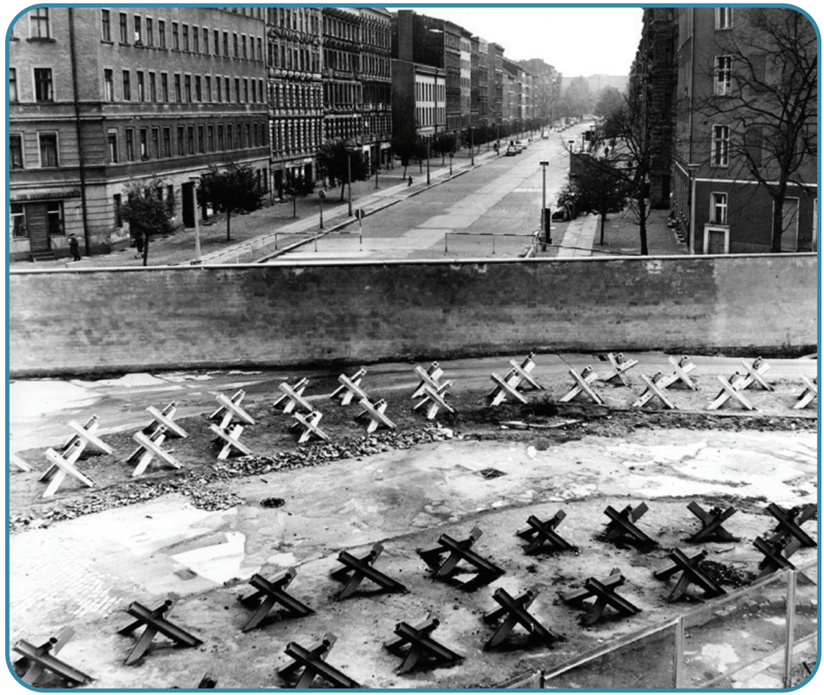
Strand Three: The History of Europe and the Wider World
Chapter Twenty-Seven: The Cold War
Diagram taken from Artefact, 2nd Edition by Eimear Jenkinson and Gregg O'Neill (educate.ie)
@MsDoorley

Slide 15
The Consequences of the Berlin Blockade and Airlift
The Soviets were prepared to increase pressure on the West but not all-out war.
  The division of Germany became permenant during the Cold War era. The three western zones became the Federal Republic of Germany (West Germany) – democratic and capitalist country. The Soviet zone became the German Democratic Republic (East Germany) – communist country within the Iron Curtain. In 1961, the Berlin Wall was built to permanently divide the city. It came to symbolise the Cold War.
  The USA, Canada and ten other Western European States set up a military alliance, the North Atlantic Organisation (NATO) in 1949.
  The Soviets accelerated their nuclear weapons programme, with their first atomic bomb detonated in 1949. They also set up a military alliance in Eastern Europe in 1955 (the Warsaw Pact).
  The Soviets’ atomic bomb started the arms race – both sides in the Cold War spent billions every year to build bigger and more powerful nuclear weapons that could wipe out the other side. Both sides spent billions every year and created huge, well-equipped armies with the latest technology.
Strand Three: The History of Europe and the Wider World
Chapter Twenty-Seven: The Cold War
@MsDoorley

Slide 16
Checkpoint pg. 405 (Artefact, 1st Edition)
  What did the Allies decide to do with Germany after World War II?
  What tensions were there between the Allies over the future of Germany?
  What provoked the Berlin Blockade?
  How did the Western Allies respond to the Blockade?
  Why did the Blockade come to an end?
  What impact did the Berlin Blockade have on (a) Germany; (b) the US and its allies; and (c) the Soviet Union?
Strand Three: The History of Europe and the Wider World
Chapter Twenty-Seven: The Cold War
@MsDoorley

Slide 17
1945-1991
Chapter 27
27.3: THE KOREAN WAR, 1950-1953
27.3: the korean war, 1950-1953
Strand Three: The History of Europe and the Wider World
@MsDoorley

Slide 18
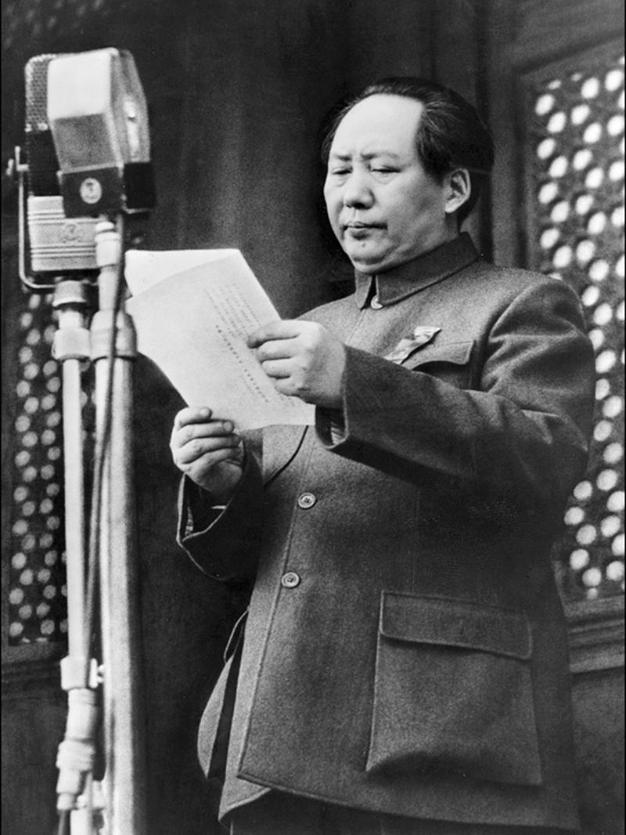
Korea after World War II
Korea was a former Japanese territory that had been divided along a map line called the 38th parallel at the end of the war. In North Korea, the Soviets established a communist government. In South Korea, a democratic and capitalist government was backed by the US. It was expected that there would be free election in 1948 to create an united, democratic Korea – these elections never took place due to rising tensions. After the victory of the communists under Chairman Mao Zedong in the Chinese Civil War of 1949 increased tensions to breaking point.
Strand Three: The History of Europe and the Wider World
Chapter Twenty-Seven: The Cold War
Diagram taken from Artefact, 2nd Edition by Eimear Jenkinson and Gregg O'Neill (educate.ie)
@MsDoorley

Slide 19
The Korean War, 1950-1953
There were several military clashes in 1949 along the border between the two states. In June 1950, the North Korean army invaded the South. They quickly took the South’s capital, Seoul, with Soviet weapons. President Truman ordered the US military to support the South and persuaded the United Nations to send an army to aid them.
In September 1950, UN Forces (mostly US but aided by 15 other countries) landed at Inchon, west of Seoul under the command of US General Douglas MacArthur. They quickly drove the North Koreans out of the South and MacArthur ordered them to advance into North Korea. The UN Forces headed for the Yalu Rive which was the border with North Korea. The Chinese believed that MacArthur intended to invade China and sent 500,000 soldiers to help North Korea.
Mac Arthur wanted to attack communist China with nuclear weapons. Truman was worried this would bring the Soviets into war, thus staring World War III so he rejected the idea. MacArthur publicly criticised Truman, with Truman responding by firing the General. The war settled into a stalemate along the 38th parallel and dragged on until 1953. In June 1953, the two sides agreed to a truce.
Strand Three: The History of Europe and the Wider World
Chapter Twenty-Seven: The Cold War
@MsDoorley

Slide 20
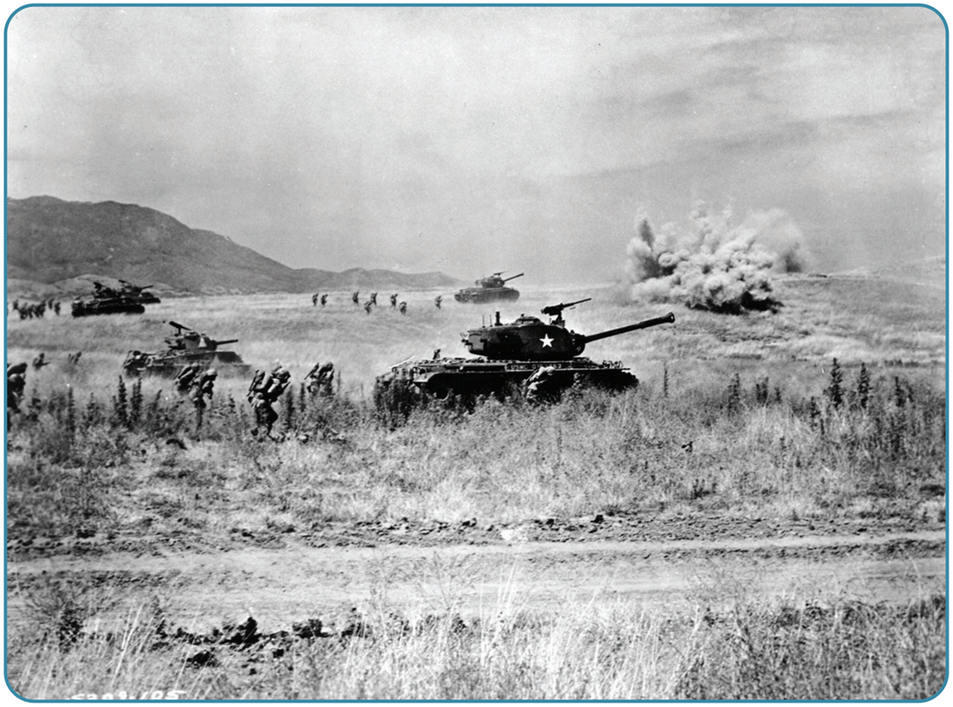
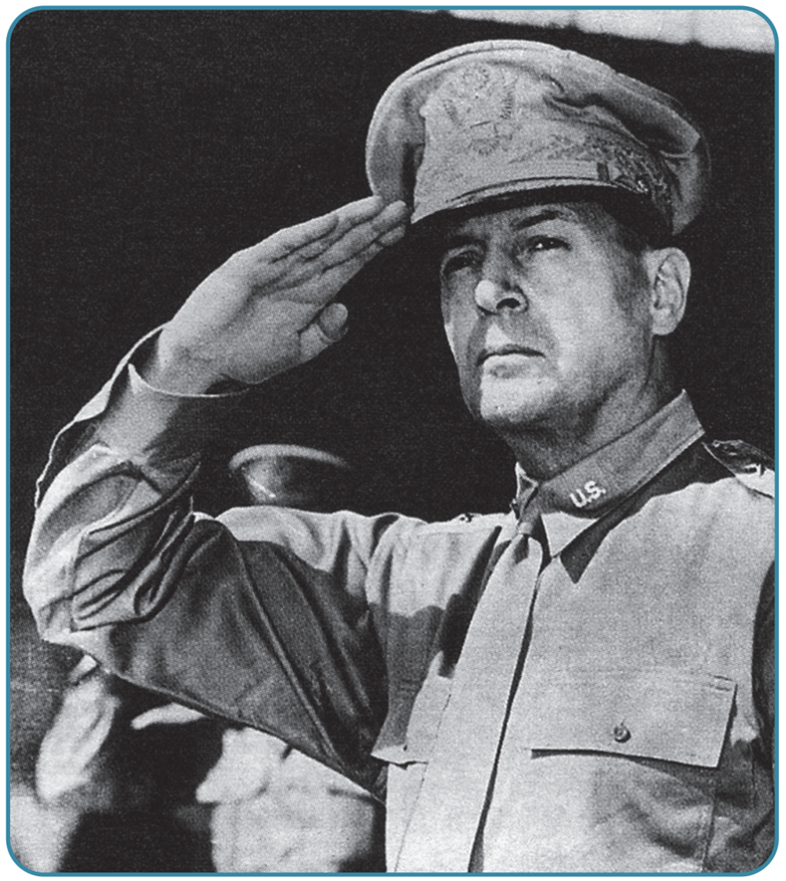
Strand Three: The History of Europe and the Wider World
Chapter Twenty-Seven: The Cold War
Diagram taken from Artefact, 2nd Edition by Eimear Jenkinson and Gregg O'Neill (educate.ie)
@MsDoorley

Slide 21
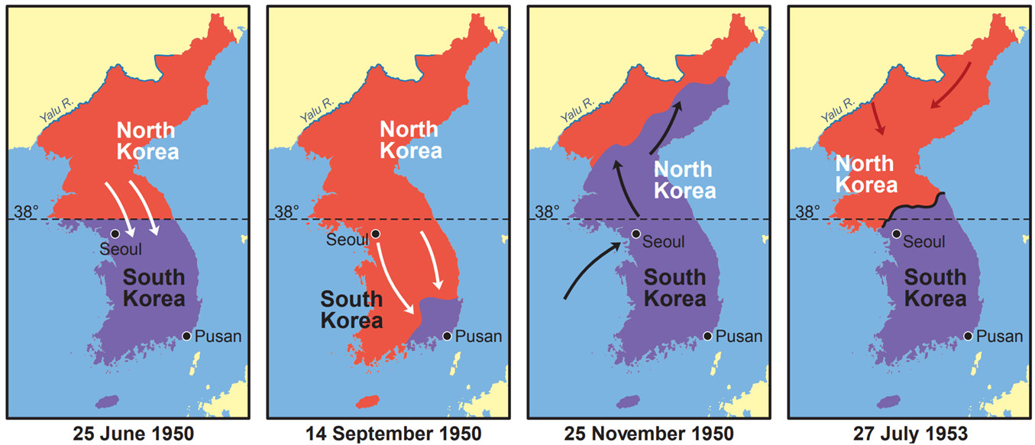
Strand Three: The History of Europe and the Wider World
Chapter Twenty-Seven: The Cold War
Diagram taken from Artefact, 2nd Edition by Eimear Jenkinson and Gregg O'Neill (educate.ie)
@MsDoorley

Slide 22
The consequences of the Korean War
  The division of Korea became permanent. The North became a brutal communist dictatorship. The South emerged as a prosperous, industrialised capitalist economy.
  The USA considered the war the second success for the policy of containment, as communism had been stopped from spreading to South Korea. As in Berlin, all-out war had been avoided while the communists had been confronted and contained.
  The Cold War divided Asia, as it had Europe. The USA gained new allies in South Korea, Japan, the Philippines, Australia and New Zealand. The USSR and China became allies.
Strand Three: The History of Europe and the Wider World
Chapter Twenty-Seven: The Cold War
@MsDoorley

Slide 23
Checkpoint pg. 407 (Artefact, 1st Edition)
  How was Korea divided after World War II?
  When did the war start?
  How and why did the US become involved?
  How and why did China become involved?
  Whey did President Truman refuse to attack China?
  What were the results of the Korean War for (a) Korea; (b) containment; and (c) Asia?
Strand Three: The History of Europe and the Wider World
Chapter Twenty-Seven: The Cold War
@MsDoorley

Slide 24
1945-1991
Chapter 27
27.4: THE BRINK OF WAR - the cuban missile crisis, 1962
27.4: the brink of war - the cuban missile crisis, 1962
Strand Three: The History of Europe and the Wider World
@MsDoorley

Slide 25
The Cuban Revolution and the Bay of Pigs
In October 1962, the world stood on the brink of nuclear war. Tensions continued to grow for some time, especially over Berlin. The crisis, however, that drove the world to the brink was the island of Cuba some 140km off the coast of Florida. In 1959, Fidel Castro led a communist revolution to overthrow the US-backed government of Cuba. Castro took over many US business, resulting in US cutting off trade to Cuba. The USSR agreed to buy Cuban sugar and to sell weapons to Castro.
US President John F Kennedy authorised the Central Intelligence Agency (CIA) to plan an invasion by anti-Castro exiles in April 1961 at the Bay of Pigs. It was a total disaster: Castro’s forces easily defeated the invaders and Castro received more weapons to defend against a future invasion. At the same time, Soviet leader Nikita Khrushchev was worried about the nuclear weapons the US had stationed in Europe and Turkey which would easily reach Soviet cities. Khrushchev offered to build missile bases in Cuba that would be able to hit cities all across the US.
Strand Three: The History of Europe and the Wider World
Chapter Twenty-Seven: The Cold War
@MsDoorley

Slide 26
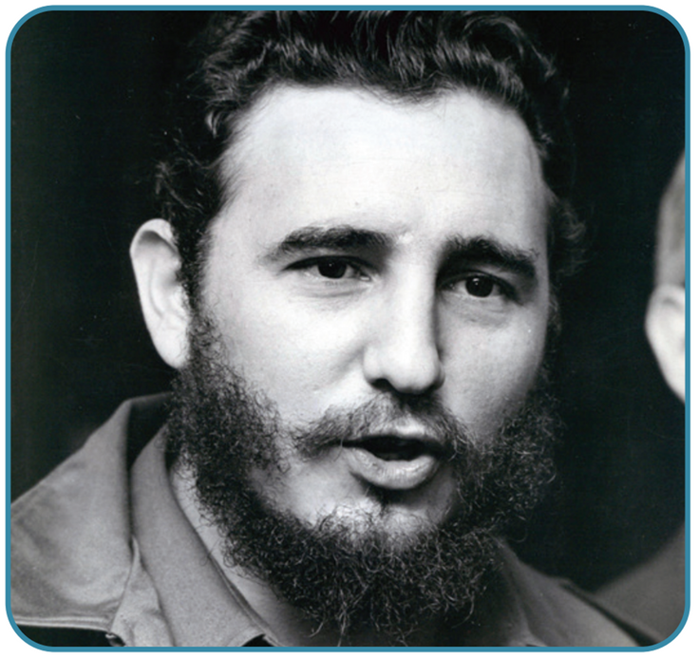
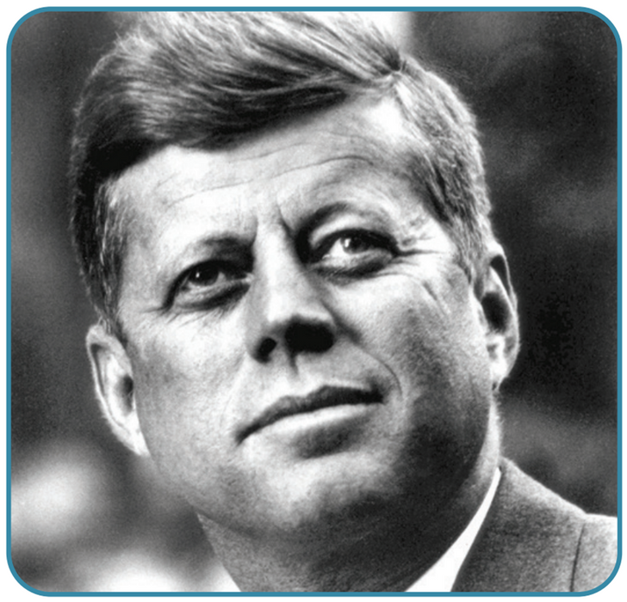
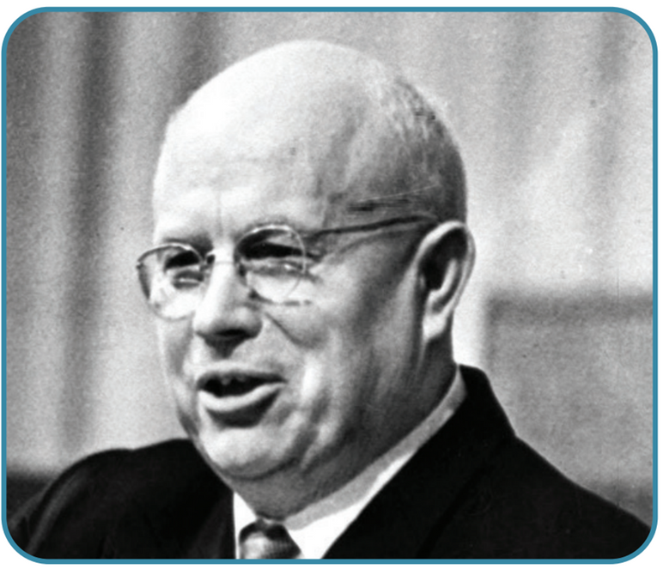
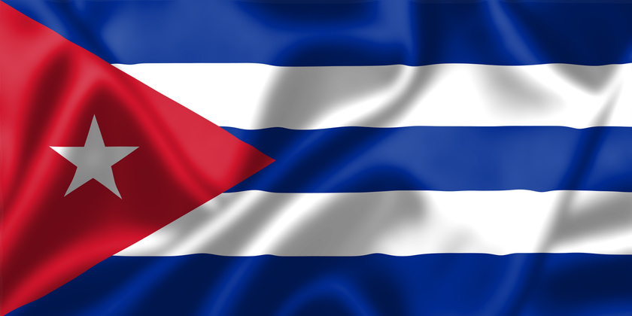
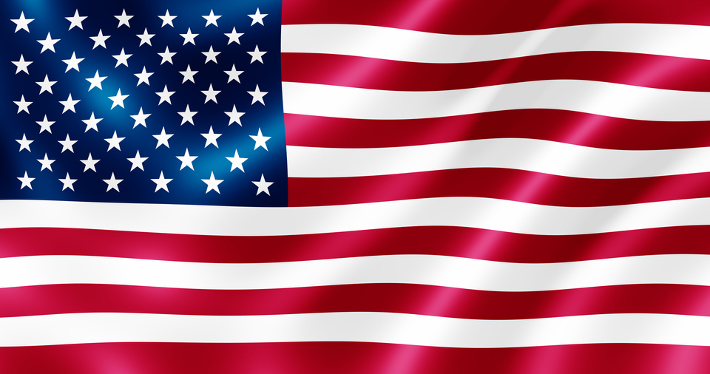
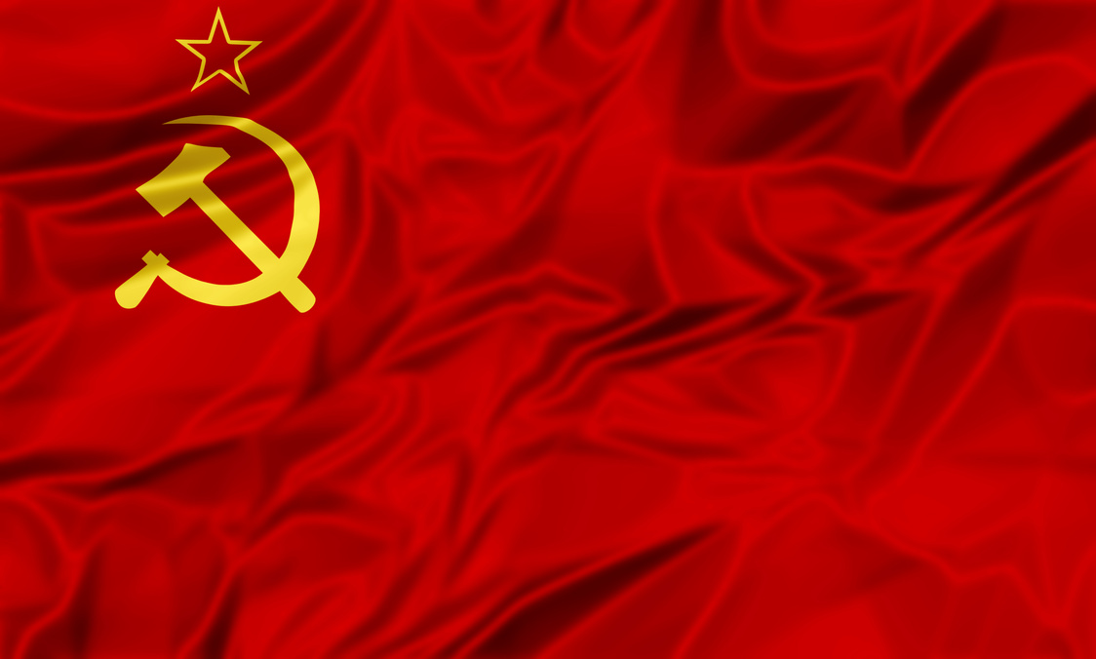
Leaders of the Cuban Missile Crisis
Strand Three: The History of Europe and the Wider World
Chapter Twenty-Seven: The Cold War
Fidel Castro
Cuba
John F Kennedy
USA
Nikita Khrushchev
USSR
Diagram taken from Artefact, 2nd Edition by Eimear Jenkinson and Gregg O'Neill (educate.ie)
@MsDoorley

Slide 27
The world holds its breath
In October 1962, an American U-2 spy plane photographed a missile base being built in Cuba. The Americans realised that these missiles could reach nearly every major US city. On television, Kennedy announced a naval blockade of Cuba. The US navy would prevent any ship from landing in Cuba until the Soviets agreed to remove the missiles. US forces around the world were on full alert. The world held its breath as Soviet ships continued to sail towards Cuba.
After several days of a tense stand-off, the two sides came to an agreement. The US publicly declared that it would not invade Cuba and Kennedy privately promised Khrushchev that he would remove US missiles from Turkey. In return the Soviets agreed to remove the missiles from Cuba, the ships turning around and returning home.
Strand Three: The History of Europe and the Wider World
Chapter Twenty-Seven: The Cold War
@MsDoorley

Slide 28
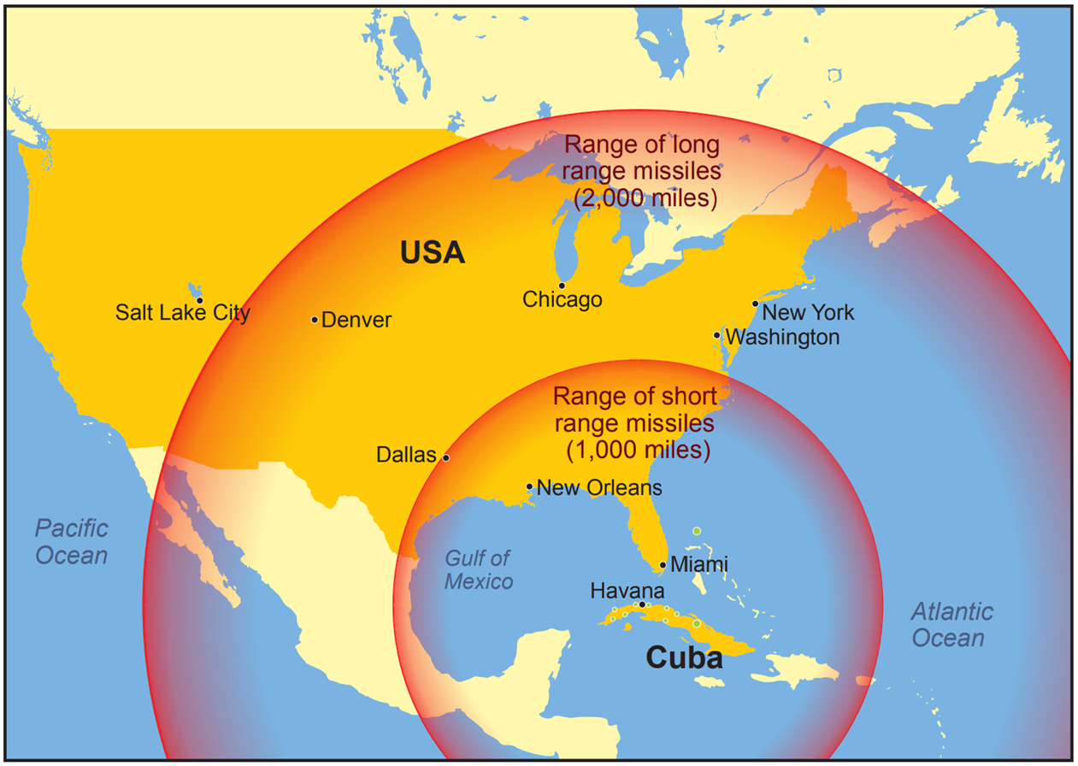
Strand Three: The History of Europe and the Wider World
Chapter Twenty-Seven: The Cold War
Diagram taken from Artefact, 2nd Edition by Eimear Jenkinson and Gregg O'Neill (educate.ie)
@MsDoorley

Slide 29
Consequences of the Cuban Missile Crisis
Both superpowers took steps to avoid nuclear war in the future.
  A telephone hotline was set up between Moscow and Washington to deal with potential crisis when they arose.
  The Nuclear Test Ban Treaty was signed, banning atomic testing on land, sea or in space.
Strand Three: The History of Europe and the Wider World
Chapter Twenty-Seven: The Cold War
@MsDoorley

Slide 30
Checkpoint pg. 366 (Artefact, 2nd Edition)
  What happened in Cuba in 1959?
  How did the US government respond to the Cuban Revolution?
  Why did the Soviet Union place missiles in Cuba in 1962?
  What did the US do when it discovered the existence of the missiles?
  How was the crisis resolved?
  What were the main results of the Cuban Missile Crisis?
Strand Three: The History of Europe and the Wider World
Chapter Twenty-Seven: The Cold War
@MsDoorley

Slide 31
1945-1991
Chapter 27
27.5: THE COLD WAR AROUND THE WORLD
27.5: the cold war around the world
Strand Three: The History of Europe and the Wider World
@MsDoorley

Slide 32
Shift in focus
After 1962, when the war was nearly plunged into nuclear war, the superpowers shifted their focus from the away from confrontation with each other to instead expand their inluence in other countries, especially in the developing world. They each backed governments that supported their side in the Cold War, or else backed rebel/subversive groups within countries whose governments were sympathetic to the other superpower. Sometimes these countries erupted into civil war, in which the superpowers got involved. These are called proxy wars, conflicts in which the superpowers provided support to different sides but did not engage each other directly. These conflicts often emerged as former colonies in Africa and Asia gained independence from European powers.
Strand Three: The History of Europe and the Wider World
Chapter Twenty-Seven: The Cold War
@MsDoorley

Slide 33
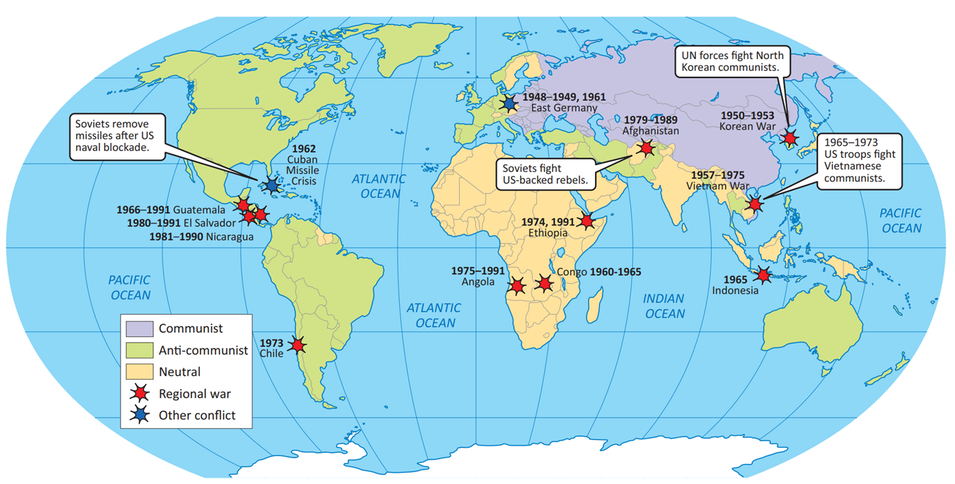
Strand Three: The History of Europe and the Wider World
Chapter Twenty-Seven: The Cold War
Diagram taken from Artefact, 2nd Edition by Eimear Jenkinson and Gregg O'Neill (educate.ie)
@MsDoorley

Slide 34
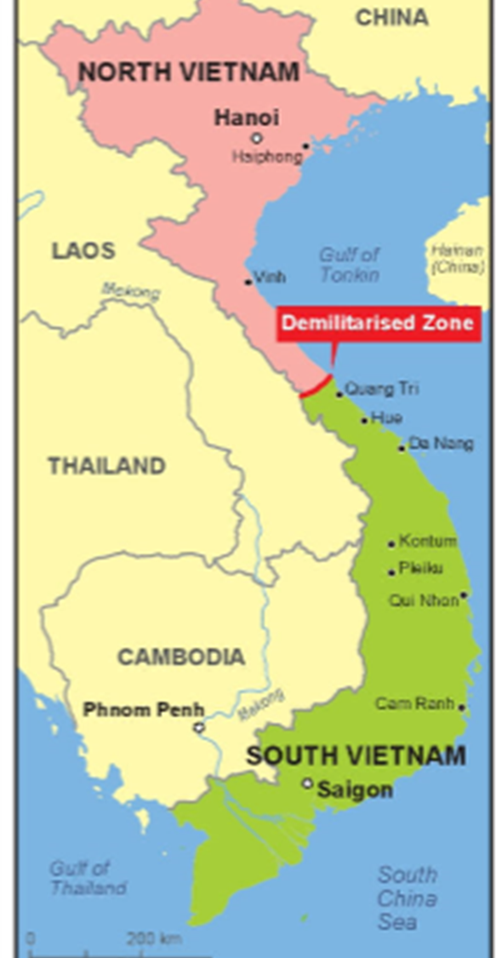
Vietnam after World War II
Before World War II, Vietnam had been a French Colony, occupied by Japanese during the war. Communist forces drove the Japanese out of the Northern half of the country near the end of the war. The French tried to return after the defeat of the Japanese but the Viet Minh under Ho Chi Minh fought back. By 1954, the French had been forced out. North Vietnam was ruled by communist while the South was ruled by a pro-Western government. Due to its policy of containment, the US had financially aided the French in their war against the Viet Minh. They also sent aid and troops to help the South after the North attacked. Initially the troops numbered in the hundreds, but that rose to 16,000 under President Kennedy. After Kennedy’s death in 1963, President Lyndon B Johnson continued to increase troop numbers until they reached 500,000 in 1968. Johnson sent them into direct combat with the communists in Vietnam in 1965.
Strand Three: The History of Europe and the Wider World
Chapter Twenty-Seven: The Cold War
Diagram taken from Artefact, 2nd Edition by Eimear Jenkinson and Gregg O'Neill (educate.ie)
@MsDoorley

Slide 35
The Vietnam War, 1954-1973
The North Vietnamese fighters, called Vietcong, adopted guerrilla tactics against the Americans and their Southern allies. They attacked in small groups, hid in the jungles and constantly disrupted their opponents’ supply lines. They had the support of the people in rural areas, who hid them and their weapons. The Americas were unable to deal effectively with these tactics. They used chemicals – primarily maple bombs – to destroy the jungles and destroy the villages where guerrillas were believed to be hiding. These actions only strengthened support for the Vietcong in many areas. The US and Viet Minh fought to a stalemate until the war’s unpopularity and protests from the anti-war movement forced President Richard Nixon to ‘bring the troops home’. In 1972, a ceasefire agreement was signed between the three parties involved. In 1973, the US began their extraction of troops. In 1975, the North launched a full-scale invasion of the South and the Southern capital of Saigon fell in April 1975.
Strand Three: The History of Europe and the Wider World
Chapter Twenty-Seven: The Cold War
@MsDoorley

Slide 36
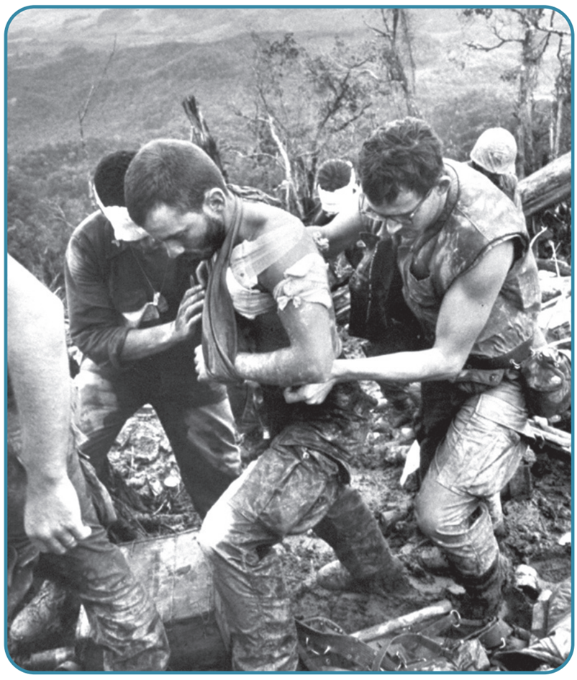
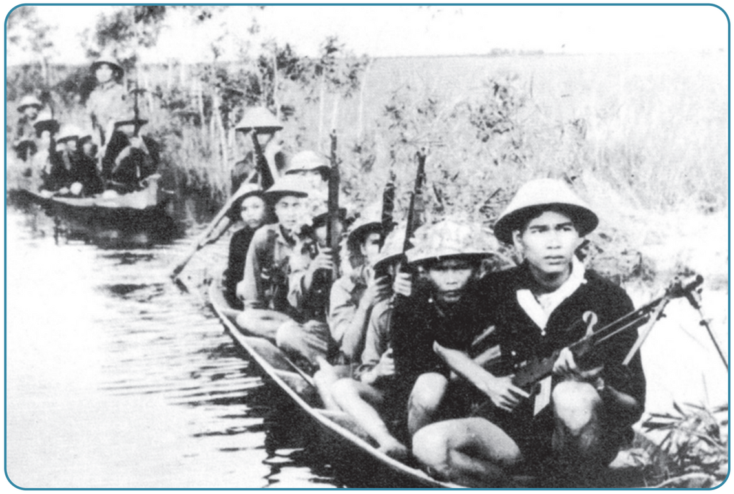
Strand Three: The History of Europe and the Wider World
Chapter Twenty-Seven: The Cold War
Diagram taken from Artefact, 2nd Edition by Eimear Jenkinson and Gregg O'Neill (educate.ie)
@MsDoorley

Slide 37
The Consequences of the Vietnam War
The policy of containment failed in Vietnam. South Vietnam became communist as well as neighbouring Laos and Cambodia. The US suffered a humiliating defeat at the hands of the guerrilla army of farmers and workers in one of the poorest countries in the world. Deep division were opened up in the US society, where many people vehemently opposed the war.
Strand Three: The History of Europe and the Wider World
Chapter Twenty-Seven: The Cold War
@MsDoorley

Slide 38
Superpower interventions in the developing world
As more countries across the developing world became independent in the 1950s and 1960s, the USA and USSR each tried to gain their allegiance. Often they intervened, directly or indirectly, to ensure that a government 'friendly' to them was in power there. For example, the USA's Central Intelligence Agency (CIA) was involved in overthrowing pro-Soviet governments in Latin America (such as in Guatemala in 1954 and Chile in 1973) and supported anti-communist guerrilla fighters in El Salvador and Nicaragua in the 1980s. The USSR acted similarly, especially in Africa, where it supported the military takeover of Ethiopia in 1974. Like the USA, it also sent troops to directly intervene in some states. In 1979, the USSR invaded Afghanistan to support a communist government against Islamic rebels called the Mujahideen. Fighting in the hills, valleys and deserts of Afghanistan, the Soviets faced the same problems as the USA had in Vietnam and were forced to withdraw in 1989.
Strand Three: The History of Europe and the Wider World
Chapter Twenty-Seven: The Cold War
@MsDoorley

Slide 39
Central and Eastern Europe under the Soviets
In the years immediately after World War II, the Soviets ensured that communist governments were set up in the countries of Eastern Europe. These countries and the Soviet Union were known as the Eastern Bloc. They kept their control over the following decades by through the following aids (but in reality were control policies):
  Economic – Comecon in 1949 was the Soviet response to the Marshall Plan; gave “financial aid” to other communist countries.
  Military – The Warsaw Pact in 1955 was the Soviet version of NATO.
  Political – Cominform was an organisation which coordinated the activities of local communist parties under Moscow’s control.
For the most part, the satellite states were allowed to run their own affairs – as long as they did not endanger communist rule. However, there were instances were Moscow became involved:
  1953: Striking workers in East Berlin were attacked by Soviet tanks.
  1956: During the Hungarian Uprising, there were mass protests against the USSR and the local communist government. The uprising was crushed after 13 days.
  1961: The Berlin Wall was built to prevent people fleeing from East Berlin to the West.
  1968: The Czechoslovakian government tried to introduce more freedoms for its people in the Prague Spring; Moscow responded by sending tanks to prevent the country leaving the Eastern Bloc.
  1980-81: Workers in Poland formed the Solidarity trade union to demand more rights and were met with martial law across the country.
Strand Three: The History of Europe and the Wider World
Chapter Twenty-Seven: The Cold War
@MsDoorley

Slide 40
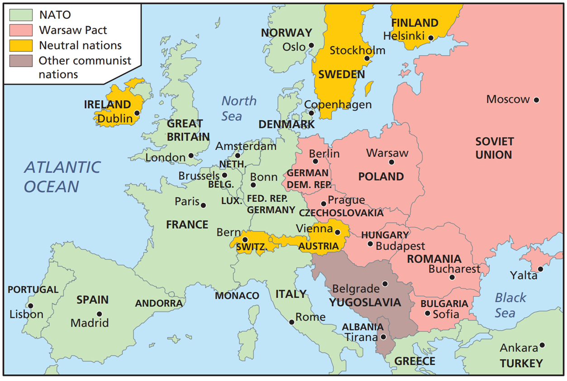
Strand Three: The History of Europe and the Wider World
Chapter Twenty-Seven: The Cold War
Diagram taken from Artefact, 2nd Edition by Eimear Jenkinson and Gregg O'Neill (educate.ie)
@MsDoorley

Slide 41
Checkpoint pg. 369 (Artefact, 2nd Edition)
  Who fought the French in Vietnam after World War II?
  What were the tactics of (a) the US and (b) the Vietcong?
  Why do you think the USA's failure in Vietnam was so important?
  How did the USA and USSR try to control countries in the developing world? Give an example of each superpowers' actions.
  What were the main objective of Soviet policy in Eastern Europe after World War II?
  What happened when those countries tried to break free of the control? Give an example.
  Why do you think the West refused to intervene in the Hungarian Uprising in 1956?
  Why do you think the Soviet threat of force was so successful at keeping Eastern Europe under control?
Strand Three: The History of Europe and the Wider World
Chapter Twenty-Seven: The Cold War
@MsDoorley

Slide 42
1945-1991
Chapter 27
27.6: THE END OF THE COLD WAR
27.6: the end of the cold war
Strand Three: The History of Europe and the Wider World
@MsDoorley

Slide 43
Ronald Reagan's stance on the Cold War
Ronald Reagan became US President in 1981. He regarded the Soviet Union as an 'evil empire' that had to be confronted and defeated. Reagan's governments massively increased its military spending to force the Soviets to do the same. Reagan believed the USSR could not afford this and would therefore have to negotiate a serious reduction in arms with the USA. He also increased US support for governments opposed to communism. He formed a close partnership with British Prime Minister Margaret Thatcher.
Strand Three: The History of Europe and the Wider World
Chapter Twenty-Seven: The Cold War
@MsDoorley

Slide 44
Mikhail Gorbachev’s Reforms
By the 1980s, the Soviet economy was in need of drastic reform. In 1985, after three elderly leaders died in quick succession, Mikhail Gorbachev was appointed leader of the Soviet Union. He believed that the cost of the Cold War was too high and that the USSR could no longer afford the arms race. He wanted to reduce military spending so that he could spend that money to improve the lives of the Soviet citizens. He oversaw two major changes:
  Glasnost (meaning ‘openness’) was Gorbachev’s policy to open up discussion in Soviet society: political prisoners were freed, censorship was relaxed and people were encouraged to suggest new ideas to fix the economy.
  Perestroika (meaning ‘reconstruction’) was Gorbachev’s policy to reform and open up the Soviet economy by allowing some private ownership of business and land.
Strand Three: The History of Europe and the Wider World
Chapter Twenty-Seven: The Cold War
@MsDoorley

Slide 45
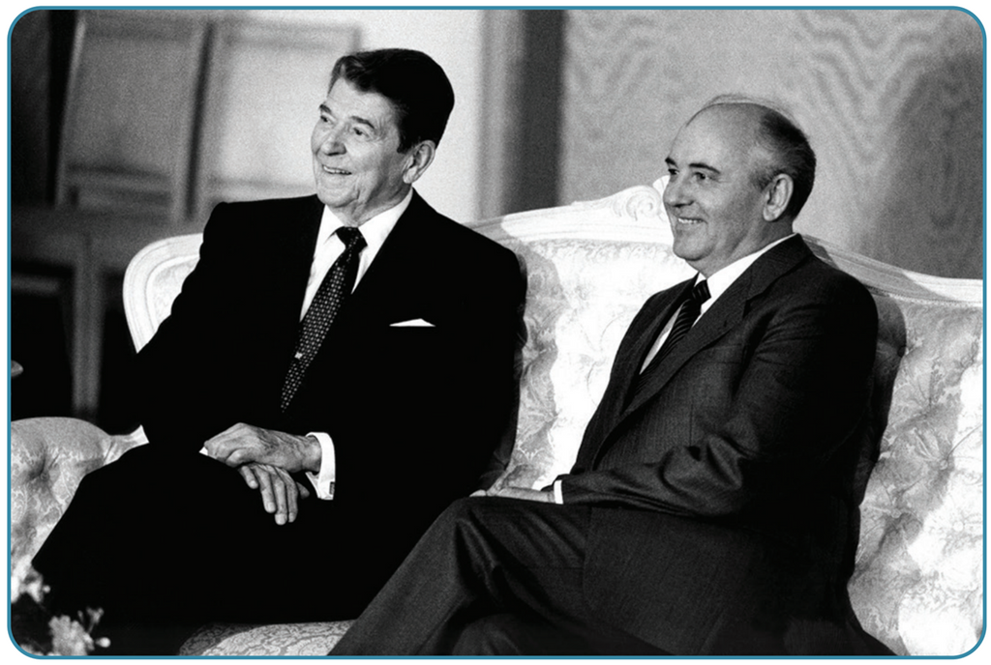
The end of the Cold War
Gorbachev saw that vast sums of money were being poured into the military to keep up with US spending of $550 billion a year under Ronald Reagan. Gorbachev and Reagan met several times and built a new relationship based on trust. They made important nuclear disarmament agreements, which dramatically reduced weaponry and tensions between the East and West.
Strand Three: The History of Europe and the Wider World
Chapter Twenty-Seven: The Cold War
Diagram taken from Artefact, 2nd Edition by Eimear Jenkinson and Gregg O'Neill (educate.ie)
@MsDoorley

Slide 46
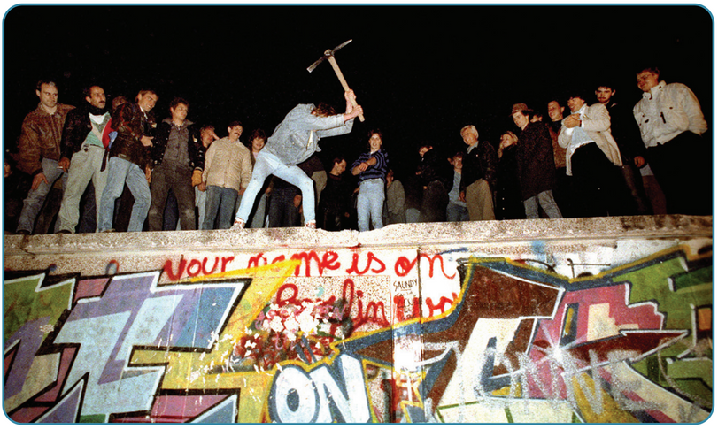
The collapse of Communism in Europe
In 1988, Gorbachev announced that the Soviet army would no longer be used to keep communist governments in power. The following year, protests broke out in all the countries under communist rule. Without the Soviet army to back them up, each of the Communist governments fell. In November 1989, the Berlin Wall – the symbol of the Cold War – was brought down.
Goverbachev’s reforms made the problems of the Soviet Union worse. The economy continued to decline, debt soared and people began to openly demand the end of communist rule. By the end of 1991, Gorbachev had lost control of the situation as states such as Estonia, Latvia and Lithuania began to break away from the USSR. He resigned as Soviet leader as a result. His resignation brought an end to the Soviet Union and the Cold War.
Strand Three: The History of Europe and the Wider World
Chapter Twenty-Seven: The Cold War
Did You Know?
Yugoslavia was a unique country in Europe during the Cold War era, as it was not aligned with the Eastern Bloc or part of the 'Iron Curtain.' Under the leadership of Marshal Josip Broz Tito, Yugoslavia pursued a path of non-alignment and managed to maintain independence from the Soviet influence that dominated other communist states. Tito's defiance of Soviet leader Joseph Stalin made him a distinctive figure in Cold War politics. Yugoslavia's period of relative prosperity came to an end with Tito's death in 1980. The vacuum left by his leadership eventually led to a series of conflicts and the dissolution of the state, resulting in the creation of seven separate nations. These events marked a turbulent and tragic chapter in the region's history.
Diagram taken from Artefact, 2nd Edition by Eimear Jenkinson and Gregg O'Neill (educate.ie)
@MsDoorley

Slide 47
Checkpoint pg. 361 (Artefact, 2nd Edition)
  What was Ronald Reagan's attitude towards the Soviet Union?
  What did Reagan do to put pressure on the Soviets?
  When did Gorbachev become leader of the Soviet Union?
  Why did he believe radical reforms were necessary?
  Explain the terms glasnost and perestroika.
  How did Gorbachev improve relations with the US?
  Why did communism collapse in Eastern Europe?
  Gorbachev has been described as the most important world leader since World War II. Do you agree? Give reasons for your answer.
Strand Three: The History of Europe and the Wider World
Chapter Twenty-Seven: The Cold War
@MsDoorley

Slide 48
1945-1991
Chapter 27
27.7: SUMMARY
27.7: summary
Strand Three: The History of Europe and the Wider World
@MsDoorley

Slide 49
In this chapter, we have learned that...
  The Cold War was the period of heightened international tension between the superpowers and their allies after World War II. There were a number of causes:
    different political and economic systems
    tensions and mistrust during World War II
    the Soviet takeover of Central and Eastern Europe behind the 'Iron Curtain'
    the US policy of containment under the Truman Doctrine and the Marshall Plan
  During the Cold War there were several major crises between the superpowers. The first in Berlin in 1948-1949, when the Soviets tried to force the Western Allies out of the city by cutting off supply lines. This failed when the Allies were able to supply the city through airlifts.
  In 1950, North Korea invaded South Korea. The UN sent armed forces to drive them back but when the USA appeared to be threatening China, the Chinese deployed a huge army to support the North Koreans. After three years of fighting, a truce left North and South Korea as separate countries.
  The closest the world came to nuclear war was during the Cuban Missile Crisis in 1962. The USA blockaded the island to prevent the Soviets from basing nuclear weapons 144km from Florida. The stand-off was eventually resolved when the USA promised not to invade Cuba and to remove its own missiles from Turkey if the Soviets removed theirs from Cuba.
Strand Three: The History of Europe and the Wider World
Chapter Twenty-Seven: The Cold War
@MsDoorley

Slide 50
In this chapter, we have learned that...
  The USA and USSR both sought to expand their influence into other parts of the world, especially the newly independent states in the developing world. The USA fought the Vietnam War in the 1960s and early 1970s, but failed to defeat the communist guerrilla fighters in the jungles. The USSR controlled the Eastern Bloc through a mixture of political domination and fear of military force, used if any of the states tried to break away from its control.
  The Cold War eventually ended in the late 1980s when the Soviet leader, Mikhail Gorbachev, decided to reform the Soviet system. He wanted to reduce military spending, and to do this he sought to reduce tensions with the West. He also was no longer willing to use military force to keep communists in power in Central and Eastern Europe. Those governments all collapsed by late 1989.
Strand Three: The History of Europe and the Wider World
Chapter Twenty-Seven: The Cold War
@MsDoorley

Slide 51
Reflecting on.... The Cold War
The Cold War dominated international relations in the second half of the twentieth century. Never before had the human race possessed the ability, through nuclear weapons, to completely eradicate all life on the planet. On several occasions, it seemed likely that World War II would break out. However, it was almost certainly the fear of mutual annihilation that kept the relative peace.
Strand Three: The History of Europe and the Wider World
Chapter Twenty-Seven: The Cold War
@MsDoorley

Slide 52
SEC Examination Questions
Strand Three: The History of Europe and the Wider World
Chapter Twenty-Seven: The Cold War
@MsDoorley

Slide 53
Project
Guidelines:
  Length: The depth of your project should reflect about 2-3 weeks of work.
  Sources: Use at least three different sources for your research. These can be books, scholarly articles, or reputable online resources.
  Citations: All information and images that are not your own should be properly cited.
  Mediums: You may choose to present your project in one of the following ways:
    Poster: Your poster should be informative and visually engaging.
    Minecraft or Lego Model: If choosing this option, please also include a brief report explaining your model.
    Painting/Drawing: Your artwork should be accompanied by a description.
    Recycled Materials: Create your model using recycled materials and provide an explanation of your creative process.
Assessment:
Your projects will be assessed based on:
  Research and Content
  Creativity and Presentation
  Understanding of Context
  Adherence to Guidelines
Strand Three: The History of Europe and the Wider World
Chapter Twenty-Seven: The Cold War
@MsDoorley

Slide 54
Project
Historical Sites
Historical Figures
Checkpoint Charlie, Berlin, Germany
Cuban Missile Crisis Bunker, Kennedy Space Center, Florida, USA
Korean War Memorial, Seoul, South Korea
Hoa Lo Prison (Hanoi Hilton), Hanoi, Vietnam
SALT I Negotiation Room, Helsinki, Finland
Harry Truman
Josef Stalin
John F. Kennedy
Nikita Khruschev
Mikhail Gorbachev
Julius and Ethel Rosenberg
Klaus Fuchs
Kim Philby
Gary Powers
Fidel Castro
Strand Three: The History of Europe and the Wider World
Chapter Twenty-Seven: The Cold War
@MsDoorley

